Slide 1
DYNAMICGRAPH ALGORITHMS
Dynamic Graph Algorithms
Valerie King
University of Victoria,
Vancouver Island,
Canada

Slide 2
Broken Group Island Problem for any A,B Q(A,B): Can we get between islands A&B?
A
B

Slide 3
Update: Add {C,D}
A
D
E
F
C

Slide 4
Update: Delete edge {E,F}
A
D
E
F
C

Slide 5
QUERY(X,Y): Is X connected to Y?
A
D
E
F

Slide 6
How to avoid O(m) cost of recomputing spanning forest with each update or running O(m) search for each query?
What would YOU do?
m=#edges

Slide 7
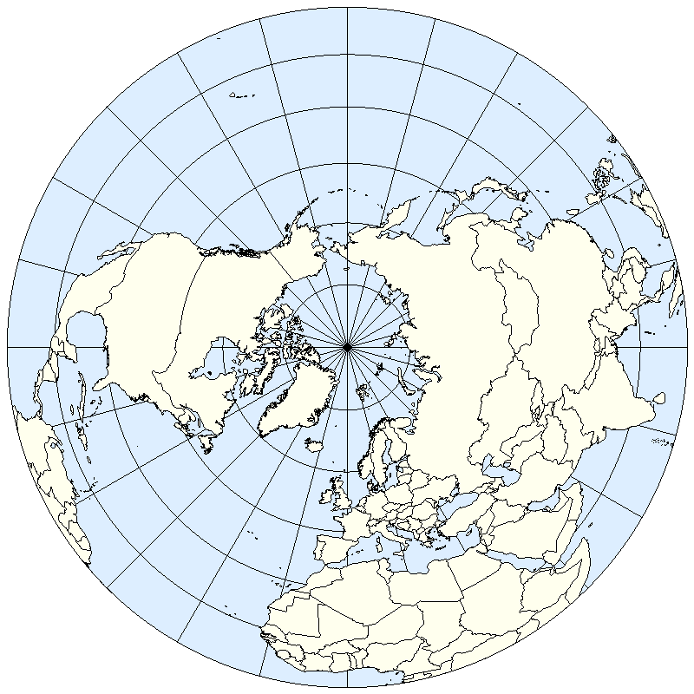
Victoria

Slide 8
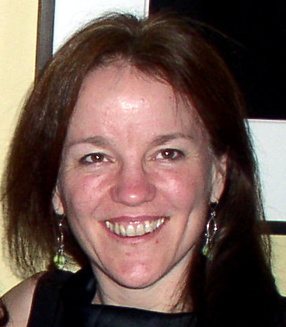
Why I worked on this problem
Tandy Warnow asked me a
Computational biology problem:
Could we speed up Aho’s method for constructing a
Phylogenetic (evolutionary)
tree from little trees?

Slide 9
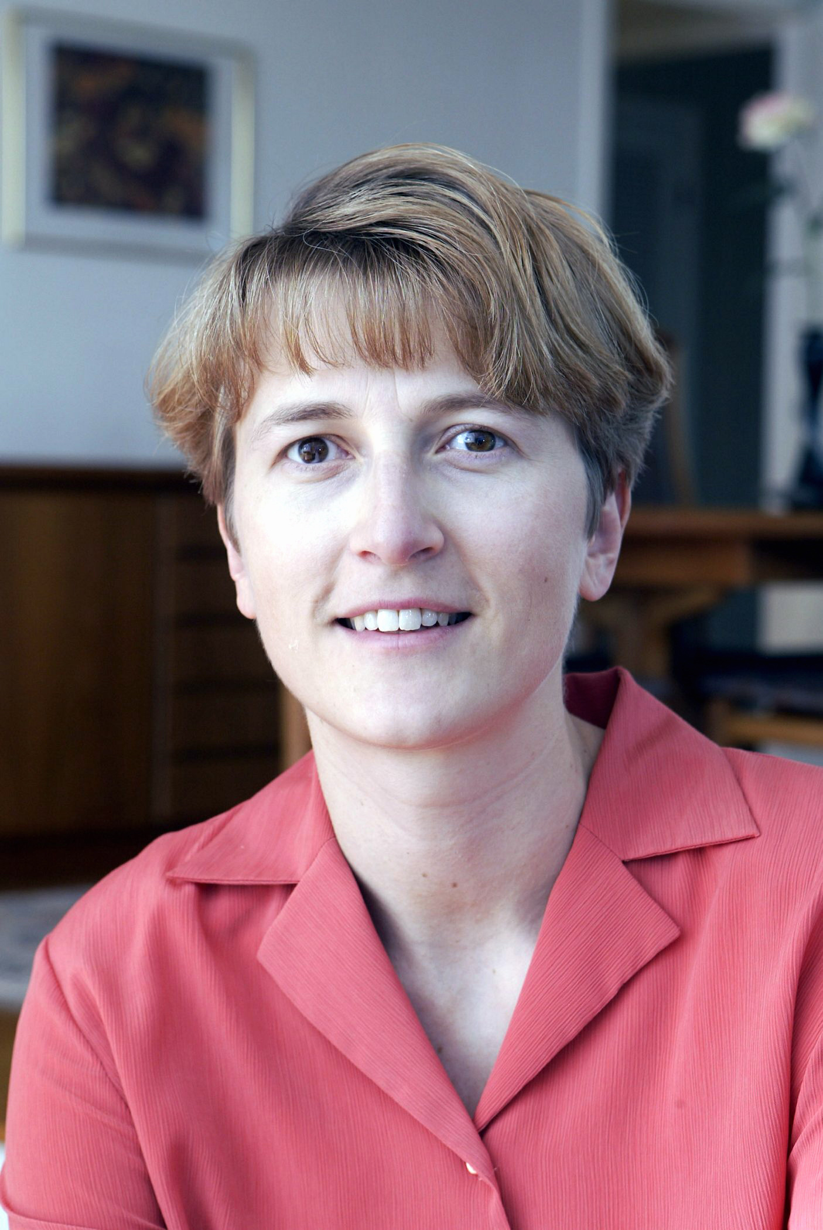
Phylogenetic tree problem
➔
ur Text➔
Hee
We need to solve dynamic graph connectivity
But we get THE THREE WOMEN SODA PAPER

Slide 10
Monika and I go on to collaborate: I have a two year old and can barely stay awake; She works like crazy. She becomes head of research at Google. I lose a collaborator….
➔

Slide 11
Dynamic graph alg=data structure
Goal: Faster than recomputing from scratch
Connectivity:
Query: Are nodes A and B connected?
Update: Insert or delete edge
n = # nodes m = #edges

Slide 12
Outline of Course key ideas, open problems
Connectivity and MST
Amortized
Worst case
Directed graphs and Shortest Paths
Lower Bounds
Other Problems

Slide 13
Partially vs. Fully dynamic algorithm partially = just edge insertions(incremental) or just edge deletions (decremental) Amortized vs. worst case analysis amortized=cost when averaged over a long enough worst case sequence of updates worst case—maximum cost update

Slide 14
Dynamic connectivity problem: Your ideas?
A
B

Slide 15
Every approach maintains a spanning forest.
Then KEY Challenge: Find replacement edge when tree edge is deleted.

Slide 16
Seven Ideas in Connectivity
Union find
Even-Shiloach breadthfirst search trees (1981)
Topology trees (clustering)(1983 Fredrickson)
Sparsification (Eppstein, et al) (1992,97)
Randomized dynamic decomposition (Henzinger, King) 1995
Deterministic dynamic decomposition( Holm, de Lichtenberg, Thorup) 1998
XOR method (Kapron, Mountjoy, K) 2013

Slide 17
Good amortized performance
Union find
Even-Shiloach breadthfirst search trees
Topology trees (clustering)
Sparsification
Randomized dynamic decomposition
Deterministic dynamic decomposition
XOR method (very new)

Slide 18
Idea 1: Use Union-find disjoint sets DS for Insertions only
Disjoint Sets Data Structure:
Makeset(x): {x}
Findset{x}: returns subset containing x
Union(x,y): replaces findset(x) and findset(y) by
findset(x) U findset(y)
e.g.

Slide 19
Idea 1: Use Union-find disjoint sets DS for Insertions only dynamic graphs
Elements= Nodes
Subsets=Connected Components
To insert {a,b}:
If $find\left(a\right)≠find\left(b\right) then union\left(a,b\right)$
To answer query(a,b)
Test $if find\left(a\right)−find\left(b\right)$
Amortized cost per operation=α(m,n) (Tarjan) (inverse Ackermann’s function)

Slide 20
Idea 1:Union find—disjoint trees
Create a node x for every node in graph
Find(x) returns root of tree containing x
While going up to root, set all pointers in tree to root (path compression).
Union(x,y): union by weight-- find(x) becomes child of find(y) if tree containing x is smaller (union by weight)
Insert (x,y): if find(x)≠find(y), union(x,y)
Query (x,y): find(x)=find(y) iff x and y are connected

Slide 21
Phylogenetic tree problem
➔
ur Tex
Hee
We need DELETIONS only and discover Even-Shiloach

Slide 22
IDEA 2: Even-Shiloach’s decremental When {a,b} is deleted:
In Parallel:
A. Maintain breadthfirst trees
B. Check to see if edge deletion splits graph into two components
.

Slide 23
Maintaining breadthfirst search tree
Each node at level k keeps list of predecessors on level k-1
If tree edge {C,D} is deleted, replace with next edge on D’s list. E.g.:

Slide 24
If D’s list = $∅:$
D moves down one or more levels
Keep Queue of elements whose level must change
Add D to Queue
Repeat until Queue is empty:
X<- pop( Queue)
Find new parent one level lower or add X back to Queue
If found: Build new list for X
Check X ‘s children’s lists
If empty, add them to Queue

Slide 25
e.g.
TOTAL COST
m*#levels=O(mn)

Slide 26
.
In parallel, test if deleting {c,d} splits graph in two
STOP when either new tree edge found or split found
Search from D
Search from C
Search in parallel until one is found to be isolated.
Cost = cost of searching smaller component

Slide 27
As a graph decomposes, a node is in a smaller component $≤$lg n times, an edge is looked at $≤2$lg n times,
--> 2m lg n total cost

Slide 28
Each idea very important for later research
TOTAL Amortized cost = O(mn + mlog n)
Breadthfirst Tree maintenance used for shortest paths and directed graphs
Search of smaller component used for connectivity and MST

Slide 29
KEY IDEA #4: Sampling and dynamic decomposition
To find replacement tree edge, sample nontree edges
incident to the smaller component to find replacement edge (

Slide 30
BUT how do you sample non-tree edges?
➔
Text➔
Hee
Monika invents ET-trees—we’ll get to this shortly

Slide 31
If an edge is found, make it a tree edge;
Else (the cut is sparse)

Slide 32
Else check ALL the edges incident to the smaller component; Move ALL edges in the cut set down to a “lower level” which is a sparser graph

Slide 33
Amortized cost per edge:
As a graph decomposes, an edge is incident to a smaller component < 2lg n times. (Even & Shiloach, Part B)

Slide 34
Each edge looked at an expected 2log n times.
Fewer
edges
Log
n

Slide 35
INSERTIONS?
Fewer
edges
Log
n
Insertions done here,
with periodic rebuilds
of levels.

Slide 36
INSERTIONS?
Fewer
edges
Log
n
Rebuild level at
height j with all edges
at j and below
when #insertions
= $2^{\left\{j−1\right\}}$

Slide 37
From deletions only to fully dynamic —>Rebuilding technique which we’ll see later

Slide 38
A brief look at trees

Slide 39
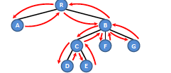
Euler Tour Tree (from Erik Demaine.’s class notes)

Slide 40
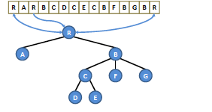
Euler Tour Tree

Slide 41
Euler Tour Tree: augmented balanced search tree
findroot, cut, link, sum of node weights in tree

Slide 42
S-T dyn, trees
A
B
D
TOP TREES can do both!
uses Fredrickson’s clusters recursively,
Variant of his “topology trees”
(Holm, de Lichtenberg, Thorup 1998)
C
E
G
Store path to root as linear
sequence. Can return max wt
in subpath of tree in
O(log n) time
Sleator, Tarjan (1983)

Slide 43
Idea 5: Deterministic Dynamic Decomposition: Holm, de Lichtenberg, Thorup, 1998:
Search through edges in smaller component until replacement edge is found.

Slide 44
Move edges which were looked at which are NOT in the cut to a “lower level”
New tree edge
Looked at before new tree edge found

Slide 45
Each edge looked at no more than log n times.
Smaller
comps
Log
n

Slide 46
To find a replacement edge, start with lowest level which contained deleted tree edge
Smaller
comps
Log
n

Slide 47
Each edge looked at no more than log n times, total amortized cost $=\log^{2}n per edge{}$
Smaller
comps
Insertions done here
Log
n

Slide 48
Works for MST?
Need to test if newly inserted edge has weight < max weight edge in fundamental cycle?
Use link-cut trees to maintain max wt in path of MST

Slide 49
Works for MST too! Sortof—except insertions don’t work
Must examine edges in
Increasing order of
weight
Smaller
comps
Log
n

Slide 50
For MST, rebuild or build new deletions-only data structure when number of insertions =$2^{i}$ This process adds $\log^{2}{n}$ factor!!

Slide 51
Henzinger, K
Introduces simple new data structure
“ET-TREES”
Holm, de Lichtenberg, Thorup
More versatile: Can implement dynamic vertex connectivity and MST using more sophisticated tree data structure, deterministic
Both have worst case update time O(n) for any one operation
But O(log²n) amortized update time (expected for HKT ).

Slide 52
Connectivity with Good Worst Case
Union find
Even-Shiloach breadthfirst search trees
Topology trees (clustering) (1992)
Sparsification (1992,7)
Randomized dynamic decomposition
Deterministic dynamic decomposition
XOR method (2013)

Slide 53
Key Idea #4: Sparsification (Eppstein et al)
Arbitrarily partition of edges

Slide 54
Form spanning forest of each= sparse certificate

Slide 55
Arbitrarily partition edges
Find spanning forest of each= sparse certificate
Form union
of sparse
certificates

Slide 56
EXERCISE
Prove: spanning forest of A U B
$⊆$spanning forest (A) U spanning forest of (B)
Also true if “spanning forest” replaced by “minimum spanning forest”

Slide 57
Sparsification
Arbitrarily partition edges
Find spanning forest of each= sparse certificate
Update affects only one side

Slide 58
Sparsification
Parent contains union of sparse certificates of children
A
B
C
m/n
Propagate up change
Update time= (log m/n )*(cost when m<2n )

Slide 59
Key idea #3. Clustering (Fredrickson, 1983)
Change to degree 3 graph by adding nodes

Slide 60
Form connected clusters of size m^{2/3}

Slide 61
Maintain edge between each pair of clusters;
Spanning tree inside each cluster

Slide 62
If internal tree edge is deleted, split cluster;

Slide 63
Delete internal edge: split cluster;

Slide 64
Clustering
Update deleted external edge: check external edges
O(m^{2/3}); merge or split neighboring clusters as needed

Slide 65
Clustering
sparsification + hierarchy → O( n^{1/2}) per update;
Also can maintain MST (with link-cut-trees).

Slide 66
When tree edge is deleted, how to find replacement edge?
D
F

Slide 67
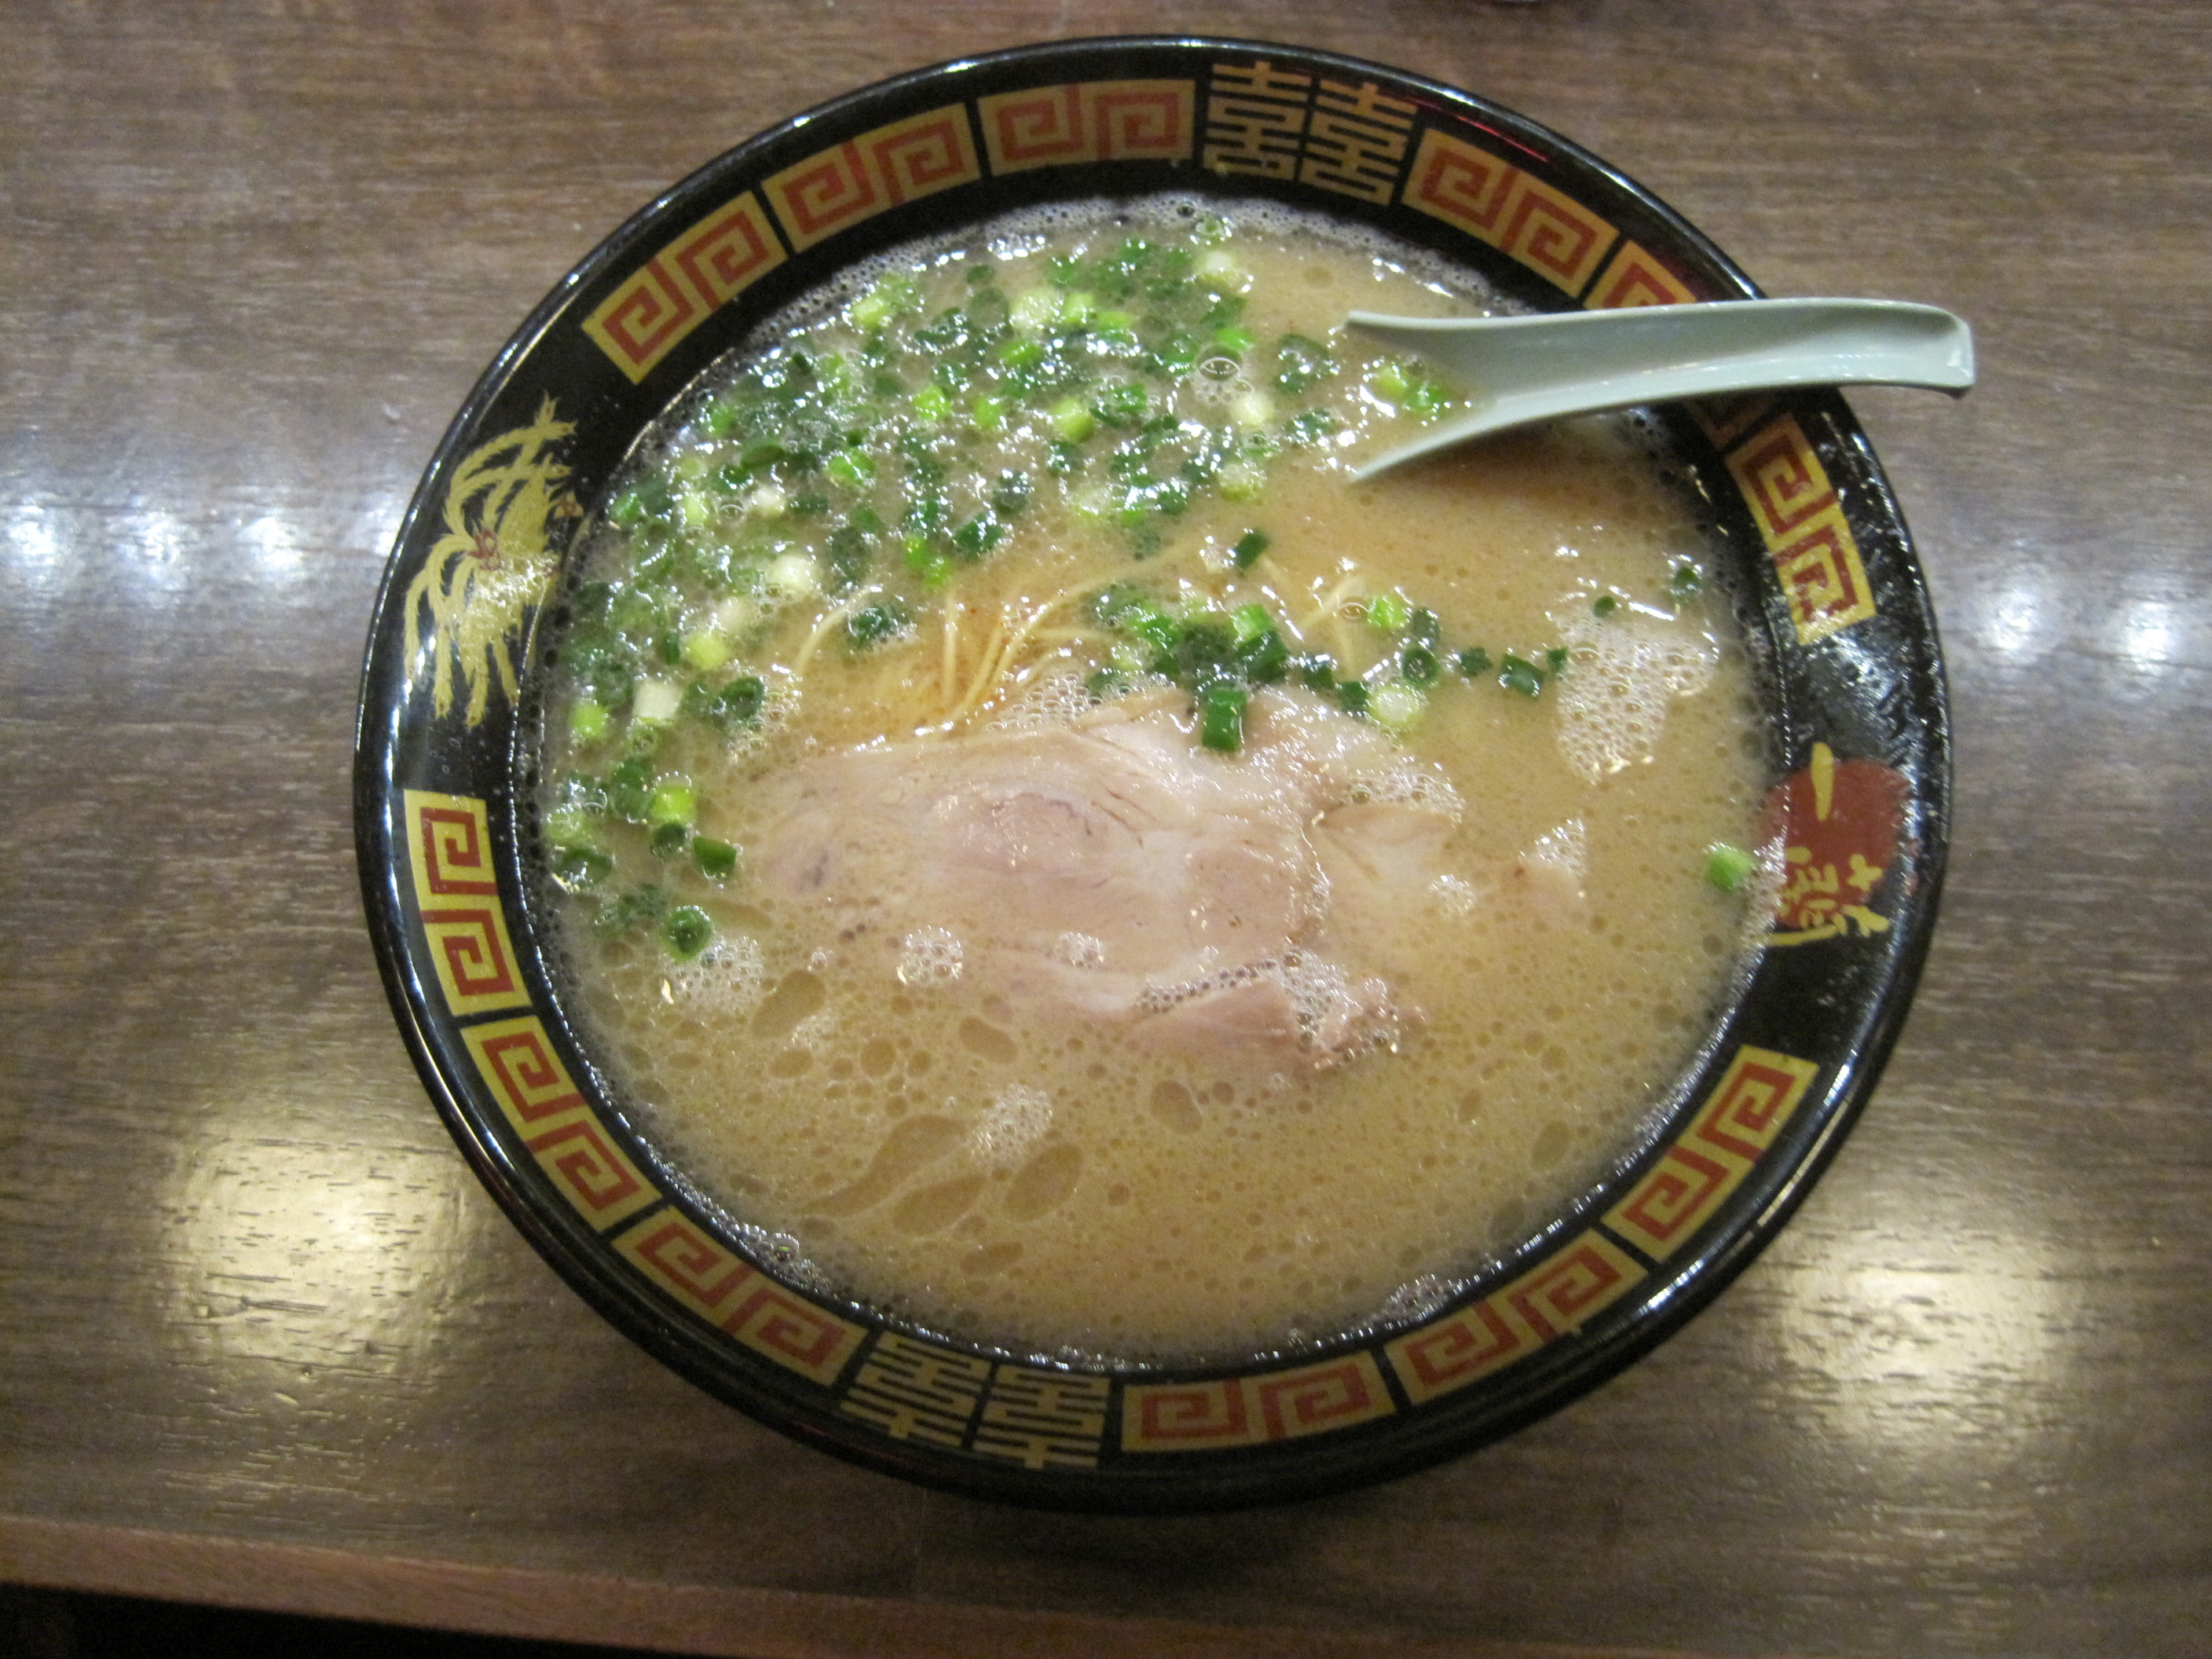
XOR method
“

Slide 68
Here, bitwiseXOR method:
V={1,2,…,n}
Form the name of {a,b}, a<b:
a (as a lg n bit number) followed by
b (as a lg n bit number)
“<ab>”
For each node a, keep a vector of bits v(a),
v(a)=bitwise XOR of names <ab> of edges
for all b adjacent to a.
For any cut (S, V\S), if there is exactly one edge {x,y} in its cutset then
XOR_{a in S} v(a) = <xy>

Slide 69
Example:
001010
1
2
3
011100
4
010101
100101
011110
5
6

Slide 70
v(a)
001010
000010
1
2
3
111001
011100
4
001010
011111
010101
100101
011110
000000
5
6
110000
011110
v(a) in T’

Slide 71
XOR of v(a) = 001010 = XOR of v(a) in V-S in S + 011111 =010101
1
001010
000010
1
2
3
111001
011100
4
001010
011111
010101
100101
011110
S
5
6
V-S
110000
011110
v(a) in T’

Slide 72
Dealing with larger cutsets
To insert:
Add <ab> to v(a,i) and v(b,i) with prob. 1/2^{i}, for i=0.,1,…,2lg n
Keep record of additions for each a and i.
To delete: Add again if it was added before

Slide 73
Dealing with larger cutsets
To insert:
Add <ab> to v(a,i) and v(b,i) with prob. 1/2^{i}, for i=0.,1,…,2lg n
Keep record of additions for each a and i.
To delete: Add again if it was added before
Observe:
C cutset of (S,V-S). For i ~lg |C|,
Pr[exactly 1 edge in C added to some v(a,i) in S] > 1/9
Repeat for log n versions. Name of exactly one edge in C appears in some version with prob 1-1/n^{c}

Slide 74
Dealing with larger cutsets
Repeat for log n versions. For each node v:
Maintain a TABLE of sums
Prob/version | 1 | 2 | 3 | … | 2lg n
1/n²
:
1/4
1/2
1

Slide 75
For each component, maintain XOR of entries of TABLEs of all nodes. W.h.p. one entry is the name of a replacement edge.
1
001010
TABLE3
1
2
3
TABLE4
011100
4
TABLE1
TABLE2
010101
100101
011110
S
5
6
V-S
TABLE 5
TABLE6

Slide 76
Over a sequence of updates:
Union bound gives small error over polynomial length sequence, provided the choice of cuts are independent of the random bits
Record enables incremental rebuilding and periodic correction of data structure to maintain prob. of error.

Slide 77
Solution to dynamic connectivity?? (not quite)
Problems:
Can’t let adversary know the spanning tree edges
Adversary sees answers to queries
--Update sequence is independent of random bits while all queries correctly answered, as they are then determined by the graph itself.
C. Choice of cut searched depends on random bits!

Slide 78
C. Choice of cut searched depends on random bits
Random bits determine spanning tree
→Determines which n-1 possible cuts we might query.
→ Possible negative correlation betw. choice of cut and prob. finding replacemt edge.
We can’t really show this to be true or false; we can just sidestep the issue.

Slide 79
C. Example of dependence
Finding a replacemt edge in TABLE entry i,j→ no other edge has been added to that entry

Slide 80
XOR method solves easier problem:
“CUTSET” DataStructure (DS)
Maintain a forest F of dynamic disjoint trees in
graph G:
Updates: insert-edge, delete-edge,
insert-tree- edge, delete-tree-edge.
Query (T), T a tree, returns an edge in the
cutset (T, V\T)
Updates MUST BE independent of random bits.

Slide 81
Cutset Data Structure
Insert tree edge, delete tree edge, insert nontree edge, delete non tree edge
Query(T): Returns edge in the cutset (T, V\T)
for the tree T (but doesn’t become a tree edge)

Slide 82
Maintain spanning forest using Cutset DS_{i,} i=0…lg n =TOP
Random bits from Cutset DS_{i} used to pick edges in cutsets in F_{i} enter F_{i+1,} joining trees from F_{i}
“Tier i+1 edge”
Query(T,k) returns a k+1 edge if it exists

Slide 83
Def: Hierarchy: trees in F_{i} composed of trees in F_{i-1} + edges
Tier
2
1
0

Slide 84
INVARIANTS:
1. F₀ is the set of all singleton nodes.
2.Structure of each F_{i} is independent of random bits from tiers i and higher.
3.Every tree on tier i is matched (linked) to
another tree on tier i by a tier i+1 edge unless it’s maximal in G
→ spanning forest by TOP tier

Slide 85
Initially, G is empty, all F_{i} are singleton nodes
TOP
0

Slide 86
Insert edge: insert into all Cutset DS_{i} If edge joins unconnected trees in F_{top} insert edge as tree edge into all F_{i} i>0
TOP
0

Slide 87
NOTE: If starting with non empty graph, F₁₌ …= F_{top} =spanning forest
TOP
0

Slide 88
Delete edge: delete from all Cutset DS_{i} Restore Invariants using Cutset Ds_{i} If deletion → unmatched tree T in tier i, find new edge in Cut (T,V-T)and insert into all F_{i’} i’>i

Slide 89
Eventually, spanning forest decomposes and edges move up in tier number
TOP
0

Slide 90
Eventually, spanning forest decomposes and edges move up in tier number
TOP
Replacement edge is a tier 2 edge
Tier 1 edge is deleted
0

Slide 91
AFTER a while: F₀

Slide 92
F₁

Slide 93
F₂

Slide 94
F₃

Slide 95
Deletion of a tier 1 edge:
A
B

Slide 96
Deletion: If unmatched tree T in tier i, find new edge in Cut (T,V-T)and insert into all F_{i’} i’>i
A
B
C

Slide 97
But new tree edge may cause an unmatched tree on a higher tier
A
E
D

Slide 98
Unmatched tree in F₂
B
E
A

Slide 99
Delete (x,y)
Delete(x, y)
remove {x,y} from all CutSet_{i} containing it.
for u in {x,y} do
while u has an unmatched ancestor in the
hierarchy do
A ←the lowest unmatched ancestor of u
k ← (tier of A)
Reconnect(A, k)

Slide 100
Reconnect(A, k)
e = {v,w} ←Query(A,k) (assume that v is the
endpoint of e in A)
if e = null then mark A as maximal
else {remove higher edge from F to break cycle}
if there is a path from v to w in F_{top} then do
e’← maximum tier edge on the path
between v and w.
Remove e’ from all F_{i} that contain it
Add e to F_{k’} for all k’ > k

Slide 101
To implement:
“if there is a path from v to w in F_{top} then do
e’← maximum tier edge on the path
between v and w.”
Use S-T dynamic trees (or TOP trees):
Maintain F_{TOP} with edges labeled by their tier number.
Find maximum weighted edge in path from v to w, O(log n) per operation.
Use ET-Trees (or TOP trees) to maintain XOR sums:

Slide 102
Analysis of deletion:
Intial edge deletion results in <= 2 unmatched trees→ <=2 edge insertions
Each edge insertion→ <= 1 cycle edge in higher tier→ <= 1 unmatched tree on higher level
Therefore:
2 tree edges per tier inserted per deletion
and log n tiers
Each edge insertion affects forests in up to lg n tiers
O(log² n) size TABLES,→O( log³ n) cost to change a tree edge
→O((2 log n)(log n) (log³ n))=O(log⁵ n)
--> O(log⁵ n) overall cost per deletion

Slide 103
SPACE
Record of insertions requires Õ(m).
Omit by using hash function for randomness, but then can only be run for poly time.
2-wise independent hash functions suffice!
(Thorup), e.g., sample if ax+b mod $2^{i}=$0

Slide 104
Open Problems in Connectivity and MST
Reduce update cost: lots of possibilities, or
modify goal to reduced worst case expected cost.
Is there a Las Vegas or deterministic alg
with polylog worst case time?
Is there a polylog worst case alg. for dynamic MST?
Improve from $\log^{4}{n}$ for amortized.

Slide 105
Euler Tour Tree (from Erik Demaine.’s class notes)

Slide 106
Euler Tour Tree

Slide 107
Euler Tour Tree: augmented balanced search tree
findroot, cut, link, sum of node weights in tree

Slide 108
Lower Bounds for Dynamic Connectivity
Ω(log n) time per operation (Patrascu, Demaine 2004)
in the
Cell probe model=#memory accesses
(where each word contains log n bits)
Also lower bounds on tradeoffs between query time and update time, e.g.:
query time * lg(update time/query time)= Ω(log n)

Slide 109
I would like to take a moment to remember Mihai Patrascu a very talented young colleague in this area whom I will miss
July 17,1982-
June 5, 2012

Slide 110
Lower Bound for Connectivity
1
2
Random distribution of BATCH updates and queries:
Prob. 1/2: replace a randomly chosen ∏_{k} by a random ∏

Slide 111
Lower Bound for Connectivity
1
2
Random distribution of BATCH updates and queries:
Prob. 1/2 do update (k) : replace a randomly chosen π_{k} by a random π

Slide 112
Lower Bound for Connectivity
2
3
1
2
Random distribution of BATCH updates and queries:
Prob. 1/2: update (k): replace a randomly chosen π_{k} by a random π
Prob. 1/2: query (k): ∀ rows i, random column k, test π_{k}(…(π₂(π₁(i))))

Slide 113
Lower Bound for Connectivity
Sequence of batch operations
Split into two time intervals
i .. j-1
j .. k
Queries here sorted by type:
Q₁< Q₂<…<Q_{k}
Updates here sorted by type
U₁ < U₂ <…< U_{k-1}
Note: High expected number L of interleaves:
U₁ < Q_{1,} < U₂ < U₃ < Q₂<…< U_{k-1}
To answer Q₂ need to know U₂ ,U₃
-->Need to know a different U for each interleaving

Slide 114
Lower Bound for Connectivity
Sequence of batch operations
Split into two time intervals
i .. j-1
j .. k
Updates here sorted by type
U₁ < U₂ <…< U_{k-1}
WRITES
Queries here sorted by type:
Q₁< Q₂<…<Q_{k}
READS
Number of READS of these WRITES must be sufficient to provide enough bits to encode L U’s.
Paper shows method for concise encoding of info from READS from which U’s can be reconstructed.

Slide 115
Lower Bound for Connectivity
Sum up expected costs over intervals given by binary tree,
Parent interval = union of children intervals.
Adds log n
factor
Note: Each read is counted once, by the lowest common
Ancestor of the read and most recent preceding write time.

Slide 117
Directed Graphs:
Victoria Road Problem

Slide 118
Reachability (transitive closure) Query: Is there a path from A to F? Shortest Paths Query: What is distance from A to F? or Query: What is the shortest path from A to F? Update: Change edges incident to a single node.
A
F

Slide 119
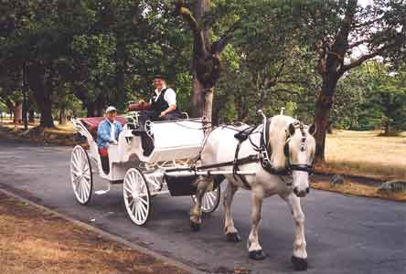
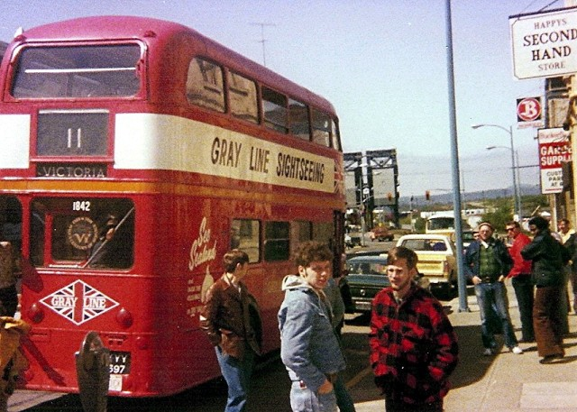
Update: Edge is deleted; Edge is inserted Edge weight is changed
Directed graph problems
A
F

Slide 120
Reachability: Simple monte carlo method for acyclic graph (K, Sagert 1998)
Directed graph problems
For each pair I, J, keep count of #Paths ( I --> J) mod p
I
C
D
J
Adding (C,D) adds #Paths(I-->C)*#Paths(D-->J)
Subtracting “ subtracts “

Slide 121
Reachability and Shortest Paths
Key idea #1: Maintaining a deletions-only breadthfirst search tree. Even, Shiloach (1981)
A
B
C
D
Use D’s Replacement Pred list={A,C} to find new predecessor

Slide 122
Reachability and Shortest Paths
Key idea #1: Maintaining a deletions-only breadthfirst search tree. Even (1981)
A
B
C
D
G
E
F
When List is empty, level drops, recompute Pred List; Modify Pred Lists of children in tree
Total cost over all deletions = m per level or O(mn)

Slide 123
Reachability and Shortest Paths
Key idea #2: In-Out Tree centered at v (K, 1998)
Breadthfirst search tree into node v
v
Breadthfirst search tree out of node v

Slide 124
Reachability and Shortest Paths
Forest of In-Out Trees to solve deletions only reachability (K99)
For each i,j, keep count = #in-out trees with i-->v_{k}->j
v1
v2
vn

Slide 125
Reachability and Shortest Paths
Speed up deletions only reachability
by maintaining Strongly Connected Components
(Roditty, Zwick 2002)
(Reduce to problem of acyclic graphs which is easier)
v
Randomly chosen v
SCC
Key Idea #3: As SCC decomposes, random node v is likely to be in LARGEST comp.
Only rebuild in-out trees for smaller comps.
Total cost ~ cost of largest tree=O(mn)

Slide 126
Reachability and Shortest Paths
Fully Dynamic Reachability: Log n levels of forests of In-Out trees, each of depth 2 (K99)
Edge (u,v) in layer k if path from u to v in layer k-1
v1
v2
vn
v1
v2
vn

Slide 127
Reachability and Shortest Paths
Fully Dynamic Reachability: Log n levels of forests of In-Out trees, each of depth 2 (K99)
Edge (u,v) in layer k if path from u to v in layer k-1
v1
v2
vn
To insert (u,v),
rebuild In-Out(u) on all layers
Amortized Cost per update =O(n² log n)
v1
v2
vn

Slide 128
Reachability Improvements
Fully Dynamic Reachability:
Reduced to maintaining product of matrices to get O(n²) amortized time (Demetrescu and Italiano 2000).
O(n²) worst case time using dynamic matrix inversion
(Sankowski 2004)

Slide 129
Shortest Paths (unweighted)
Key Idea #4:
A randomly chosen set of n^{1/2} log n nodes splits every (unique) shortest path into intervals of length O(n^{1/2} ) .

Slide 130
Shortest Paths (unweighted)
Key Idea #4: A randomly chosen set S of n^{1/2} log n nodes splits every shortest path into intervals of length O( n ^{1/2}).
Maintain paths up to length n^{1/2}
Use nodes in S to join short paths together, O(n^{2.5}log n) (K99)
v1
v2
vn

Slide 131
Shortest Paths for real weights in O(n² log²n) amortized update time (Demetrescu, Italiano 04 mod. by Thorup 04)
DEF: old shortest paths (“Zombies” )
A path which was a shortest path at some previous time t which has not been updated or
“de-selected” since.
DEF: generated paths
A path is generated if, no matter which endpoint is removed, the resulting path is an old shortest path. A vertex is generated.
DEF: improving paths
A path which is shorter than any old shortest path alternative

Slide 132
Shortest Paths for real weights (Demetrescu, Italiano 04 mod. by Thorup 04)
Lemma: After an update, if P is a shortest of all improving generated path, it is a shortest path
Alg: For each pair of nodes (s,t) keep priority queue
min
s,t
Generated paths from
s --> t

Slide 133
Shortest Paths for real weights (Demetrescu, Italiano 04 mod. by Thorup 04)
Lemma : After an update, if P is a shortest of all improving generated path, it is a shortest path
min = shortest path
Alg: For each pair of nodes (s,t) keep priority queue
Use new
Shortest
Paths
to
form new
gen.paths
(for other
pairs)
Global heap
min
s,t
Insert new edge
Generated paths from
s --> t

Slide 134
Shortest Paths for real weights (Demetrescu, Italiano 04 mod. by Thorup 04)
Lemma : After an update, if P is a shortest of all improving generated path, it is a shortest path
To insert:
Alg: For each pair of nodes (s,t) keep priority queue
Use newly found shortest
paths to form new gen.paths
(for other pairs)
To delete: remove all paths from all data structures
which contain deleted edges

Slide 135
Shortest Paths for real weights (Demetrescu, Italiano 04 mod. by Thorup 04)
Using pointers,
each generated path can be formed in O(1) time
Static case: there can be O(n³ ) generated paths if all shortest paths are generated from scratch
If only current shortest paths are kept they can all be killed and need to regenerated.
Alternatively, if all old shortest paths kept, a
sequence of insertion/deletions can cause
O(n³) changes in generated paths repeatedly.
Solution: keep some old paths in queues but
deselect periodically

Slide 136
Directed Graphs
Open Problems:
-Single source reachability in o(m)?
-Fully dynamic strongly connected components?
-Closing gap between worst case O (n^{2.75} )(Thorup)
and amortized O(n² log²n).
-Maintaining maximum flow?
Other closely related results:
Trade-offs between query time and update time using fast
matrix multiplication, in-out trees;
Approximate shortest paths

Slide 137
Lower Bounds for Dynamic Connectivity
Ω(log n) time per operation (Patrascu, Demaine 2004)
in the
Cell probe model=#memory accesses
(where each word contains log n bits)
Also lower bounds on tradeoffs between query time and update time, e.g.:
query time * lg(update time/query time)= Ω(log n)

Slide 138
Lower Bound for Connectivity
1
2
Random distribution of BATCH updates and queries:
Prob. 1/2 do update (k) : replace a randomly chosen π_{k} by a random π

Slide 139
Lower Bound for Connectivity
2
3
1
2
Random distribution of BATCH updates and queries:
Prob. 1/2: update (k): Replace a randomly chosen π_{k} by a random π
Prob. 1/2: query (k):
∀ rows i, random column k, test π_{k}(…(π₂(π₁(i))))

Slide 140
Lower Bound for Connectivity
Sequence of batch operations
Split into two time intervals
i .. j-1
j .. k
Queries here sorted by type:
Q₁< Q₂<…<Q_{k}
Updates here sorted by type
U₁ < U₂ <…< U_{k-1}
High expected number L of interleaves:
U₁ < Q_{1,} < U₂ < U₃ < Q₃<…< U_{k-1}
To answer Q₃ need to know U₂ ,U₃
-->Need to know a different U_{i} for each interleaving,

Slide 141
Lower Bound for Connectivity
Sequence of batch operations
Split into two time intervals
i .. j-1
j .. k
Updates here sorted by type
U₁ < U₂ <…< U_{k-1}
WRITES
Queries here sorted by type:
Q₁< Q₂<…<Q_{k}
READS
Number of READS of these WRITES must be sufficient to provide enough bits to encode L U’s.
READS can be concisely encoded-->lower bound on#READS

Slide 142
Lower Bound for Connectivity
Sum up expected costs over log n layers of time intervals
Parent interval = union of children intervals.
Adds log n
factor
Note: Each read of a write is counted once,
when write is in left subtree (when cell last written)
and read is in right subtree.

Slide 143
In conclusion : Many problems, many directions
important open problems
Other dynamic graph properties: Recognizing chordal, planar, proper interval, distance hereditary, geometric problems, etc.
Distributed dyn algs for spanners.; (M. Elkin, PODC 2007)
Parallel complexity classes for dynamic problems (Immerman)
Routing with distributed selfish agents (j.feigenbaum)
Related problems: Edge replacement,
Planning for an emergency, off-line, kinetic
data structures (Guibas).
Applications to static problems (Karger)

Slide 144
Victoria, British Columbia
ACM Symposium on the Theory of Computing
(STOC) 2008
May 17-20

Slide 145
Thank you Any questions?

Slide 146
Else the cut is SPARSE
Check ALL the edges incident to the smallest component;

Slide 147
IDEA 2B: from Even’s deletions only (1981)
To see if deletion disconnects tree
search search
Search in parallel until one is found to be isolated.
Cost = cost of searching smaller component
.

